Slide 1
Mobile Node Pilot
Fernando Gros González
18-12-2012

Slide 2
Table of contents
Introduction
Main Phases
Current Progress

Slide 3
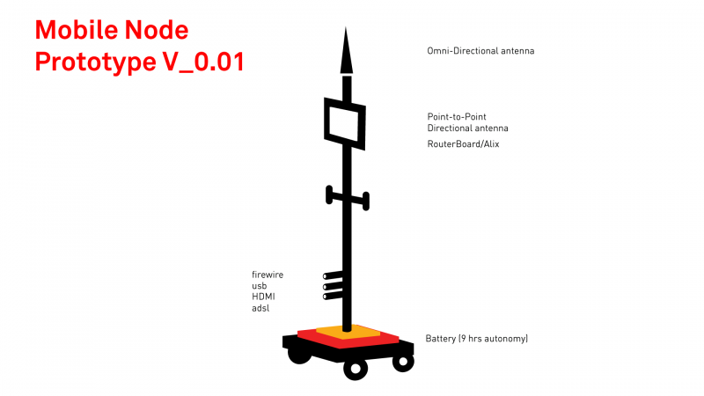
Introduction
The main idea within the Mobile Node Pilot is to create a free transmission workstation that can be used in the urban space and contributes to the digital mesh through other networks.

Slide 4
Main Phases
Documentation: Analyzing and study all the prototypes and tests that have been made and document them. In addition, a handbook can be written.
Active role in the second phase of the project: Interesting to have the freedom to make proposals and do some tests that can provide the mobile node with any additional value that can be useful to make it more attractive for the final users.
Build my own Mobile Node: Having my own Mobile Node would let us make several tests and so, we would be able to propose some changes or improvements and test them before in order to accept or discard them.

Slide 5

Current Progress
Meeting With Efraín
Test of the mobile node in December

Slide 6
Thank you for your time!

